Slide 1

Power platform
In a day
Valorem Reply

Slide 2
Prerequisites
So everything runs smoothly
Power BI
Power BI Desktop installed and up-to-date
A Power BI Service account
Basic knowledge of the tool
Power Apps
A Power Apps license
Basic knowledge of the tool
Power Automate
A Power Automate (Flow) license
Basic knowledge of the tool
General
Internet connection (or hot spot)
An I.T. department that trusts you
Teams/Devops/Gmail/Trello/etc.

Slide 3

introductions
Name
Business
What you want to learn
A terrible joke (if you know one)
Notes:
Speaker introduces themselves
Asks participants to do the same and answer some questions
“What you want to learn” should be captured on a whiteboard for review during Q&A

Slide 4




Power platform
A low-code / no-code platform for business users
Analyze
Act
Power BI
Power Apps
Power Platform
Automate
Power Automate
Notes:
- A high level overview of what Power Platform is

Slide 5
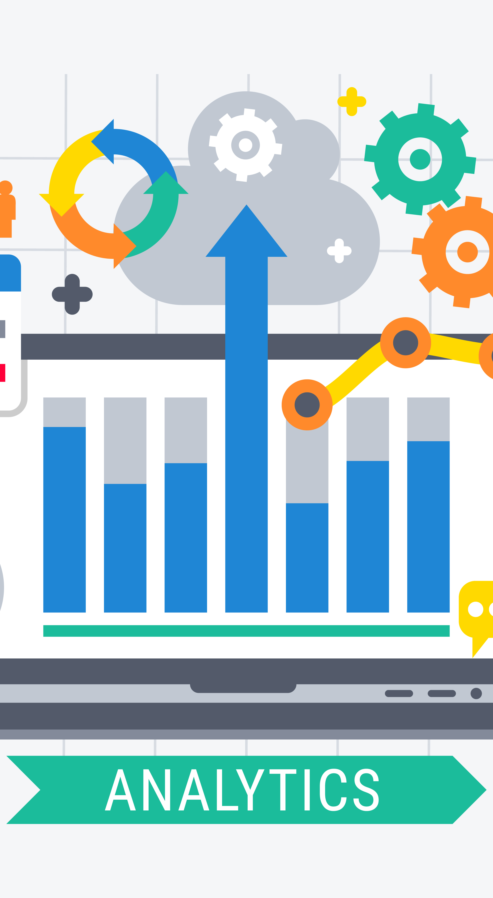
POWER BI 9:00-11:00
Intro to Power BI
Business Scenario
Lab Work
AGENDA
Power Automate 11:00-12:00
Intro to Power Automate
Business Scenario
Lab Work
Break 12:00-12:30
Q&A 12:30-12:45
Power apps 12:45-2:00
Intro to Power Apps
Business Scenario
Lab Work

Slide 6

Power BI & The bi cycle
1
GET DATA
Source system to staging
Logic Apps, Azure Data Factory
2
CLEAN DATA
Staging to semantic layer
SSIS, PowerQuery
3
ANALYZE DATA
Informally in Excel of formally by a Data Scientist
Python, Databricks
4
VISUALIZE DATA
Semantic to Reporting
Analysis Services, SSRS
5
EVANGELIZE DATA
Reporting to Adoption
Microsoft Stream, SharePoint

Slide 7

Business scenario
7
Notes:
You’re a newly hired BI analyst hired to work directly for the VP of Sales
Day one, your new manager pulls you into her office and says,
“Bob, I’m sold on the value of being data driven but I’ll be honest, the rest of the sales team is not. Here’s what I need from you to prove this is worth the effort
I need a report showing me which regional sales managers are doing well and which are doing poorly for Q1
They each have a goal to have their sales be 2% higher than this month last year
Most of my salespeople are old school. They don’t want to learn a complicated new tool, so find a way to show them something cutting edge but still simple to use
Finally, it would be nice to see how things are trending over time and what might be the main contributors to success or failure might be
Oh and it needs to look snappy. We’re going to put it on the big TV in the main sales office

Slide 8
TIME OUT
LET’s talk PROCESS & BEST PRACTICES
Notes:
Let’s talk through how to approach a business problem like this one. Take three steps before you begin.
First, email your boss a summary of your conversation and lay out
Goals
Action Items
Deadlines
Second, ideate. What would a perfect solution look like?
Example: the development of the Amazon warehouse robot
Third, consider your toolbox. What different ways could you solve the problem?
Then follow the Harvard School of Design model.
Rapid prototyping with minimal time invested
Start with a napkin drawing if you have to
SCRUM/Agile/KANBAN methodologies can be useful in this scenario but don’t get too caught up in that

Slide 9
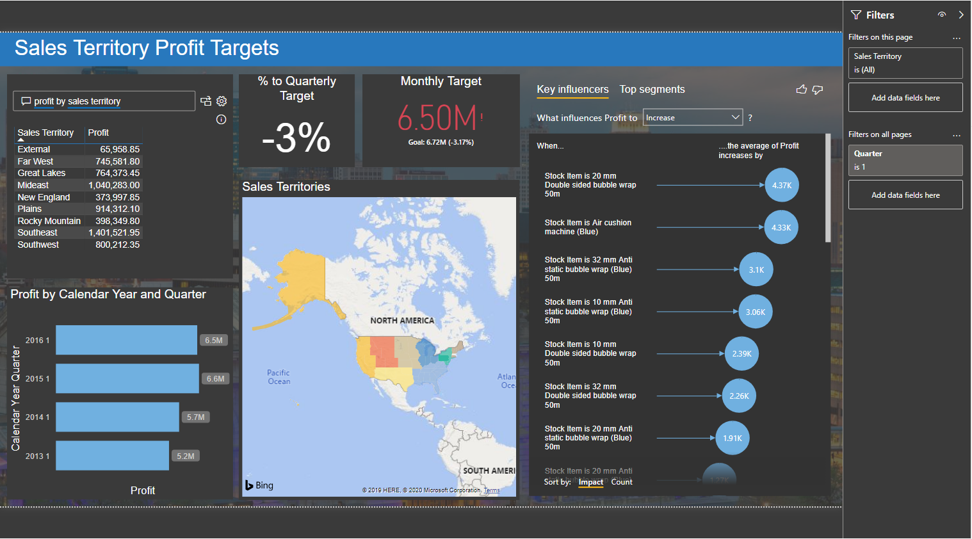
Lab work
Regional sales, by manager for Q1
Compare sales to goal (2% higher than prior year)
Simple but cutting-edge
Sales trends
What causes success or failure?
Notes:
Regional sales data compared to a goal
Build a goals table that shows the current year goal that’s 2% higher than last year
A cutting-edge feature that’s dead easy to use
Trends over time
Contributors to success or failure
Snappy look

Slide 10
Business scenario
10
Notes:
You show the report to your boss and she loves it.
She sends you of to present to Kevin, one of the salespeople
Kevin likes it but he’s skeptical and tells you a story
We had some reports like this built on an old system but we could never trust them
Probably once a week some data table or another wouldn’t get refreshed and everything would get out of date and wouldn’t be accurate
You go back to your boss and together the two of you decide to build another report that shows data quality and freshness
It needs to show three things
First, did Power BI itself refresh?
Second, did the SQL tables refresh?
Finally, did our source system refresh?
As you’re walking out the door your boss adds one more thing. She wants to hold the salepeople accountable to use the new dashboard so wants to know if any person hasn’t used the report in the last 30 days

Slide 11
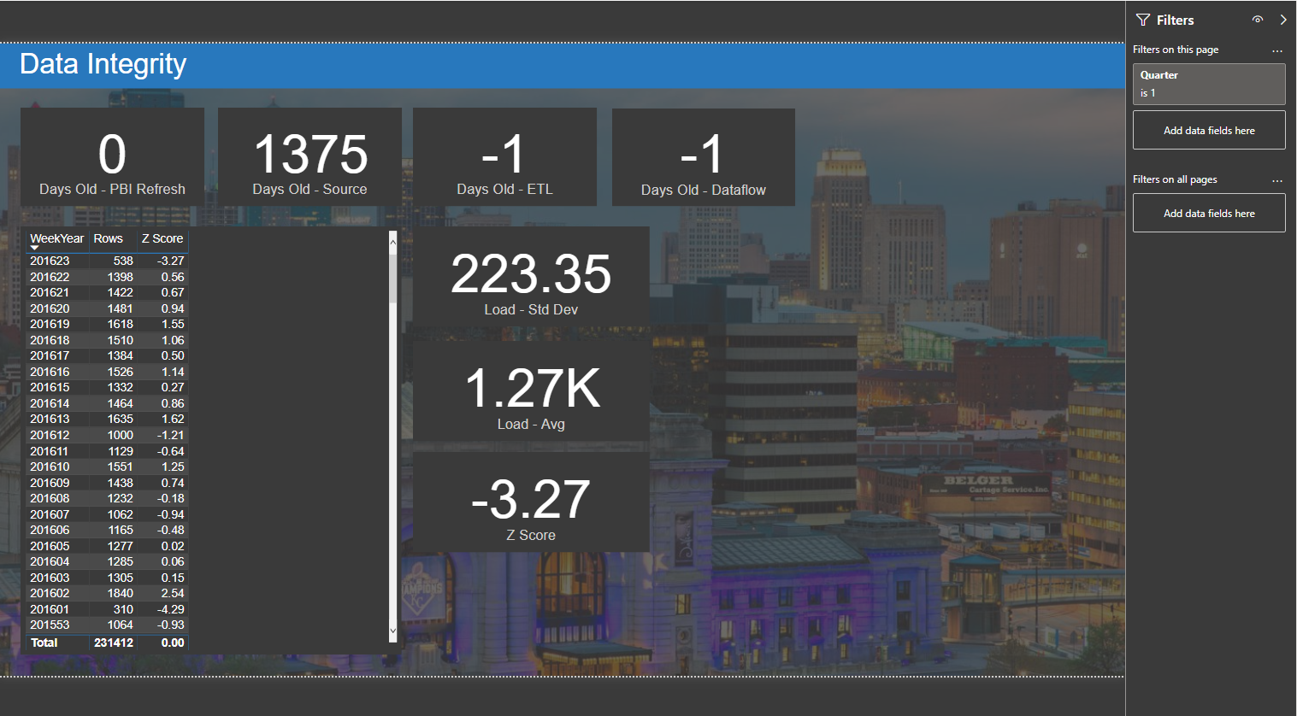
Lab work
Did the data get all the way from the source to PowerBI?
If so, when?
Who is accessing these reports?
Notes:
Three refresh dates (Power BI, SQL, and Source)
A view to see if anyone hasn’t used the report in 30 days

Slide 12
Business scenario
12
Notes:
Both your boss and Kevin are liking the new system. After a couple of weeks, your boss calls you in
She wants to find a way to reward her team for meeting their goals and using the new PBI report
She wants
To be notified if a region meets their sales goals
IF they do, she wants to buy them a team lunch (which will have to be approved by finance)
She also wants to give them a shout out on Teams

Slide 13
TIME OUT
LET’s talk PROCESS & BEST PRACTICES
Notes:
Going back through our process, reconsider your tools. Power BI is no longer the best tool for the job.
We need a tool that can provide active communication and interact with other pieces of software

Slide 14
Power automate
1
CONNECTIONS
Login information for your accounts
O365, Salesforce, SQL Server
2
CONNECTORS
The software you want to communicate with
DevOps, Outlook, Teams
3
TRIGGERS
What thing will happen to start a Flow
Getting an email, a new row in table
4
EVENTS
What will happen because of the trigger
Archive a document, create a new task

Slide 15
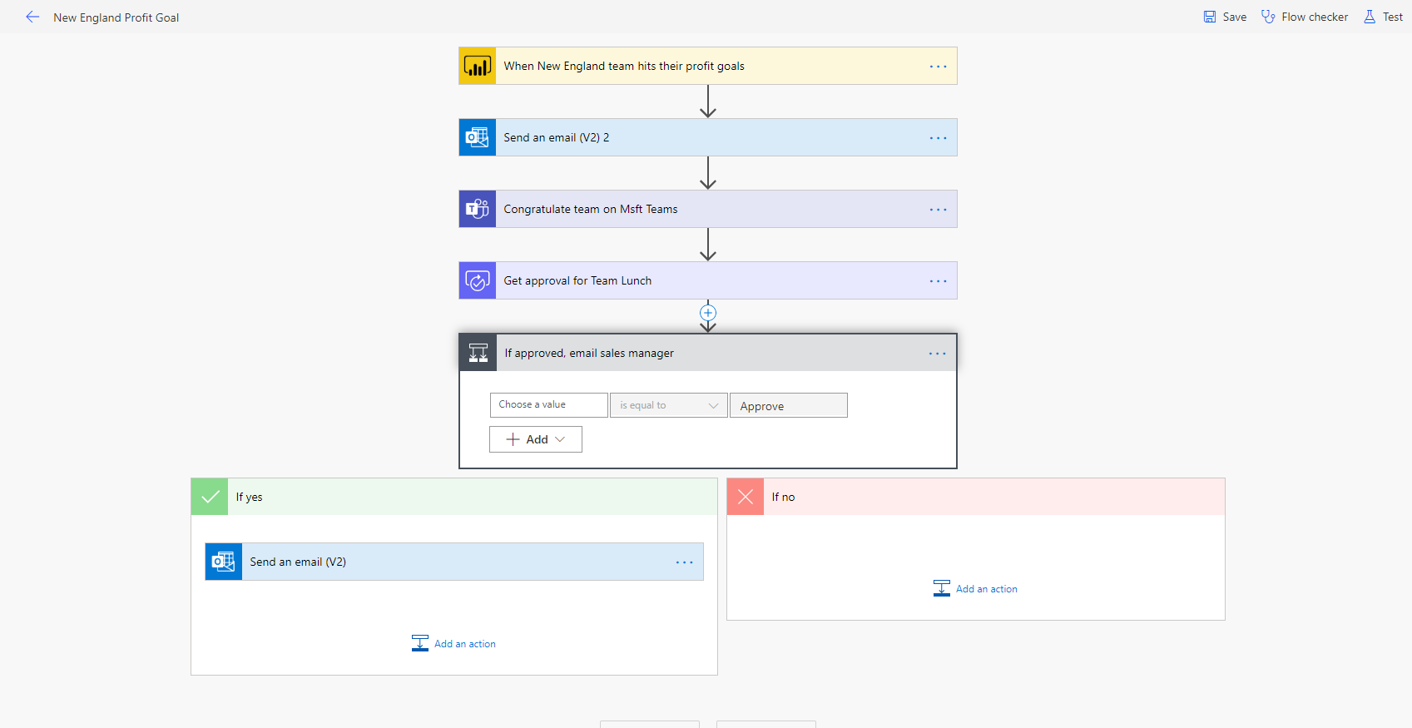
Lab work
If a sales region meets their goal, get approval to buy the sales team lunch
Also give them a shout-out
Notes:
Notification if a regions sales goal is met
Kick off a finance approval for a team lunch
Also need to post a message to team

Slide 16
Business scenario
16
Notes:
Your boss likes the new system and is really impressed by Power Automate
Unfortunately, she doesn’t spend long talking about that because Kevin called in to complain that the report was out of date
Your boss wants to find a way to use Power Automate to let IT know if any of the refreshes don’t happen
She also wants to log a bug in Azure DevOps so she can track progress
It would look proactive if you were able to send an email to the sales team letting them know something was wrong and you were working on it
And if we can let people automatically know when the issue is resolved, even better
Add in PRI refreshes itself when the bug is done.
Finally, she wants to keep track of these bugs somewhere so she can review them with the IT team at the end of the year

Slide 17
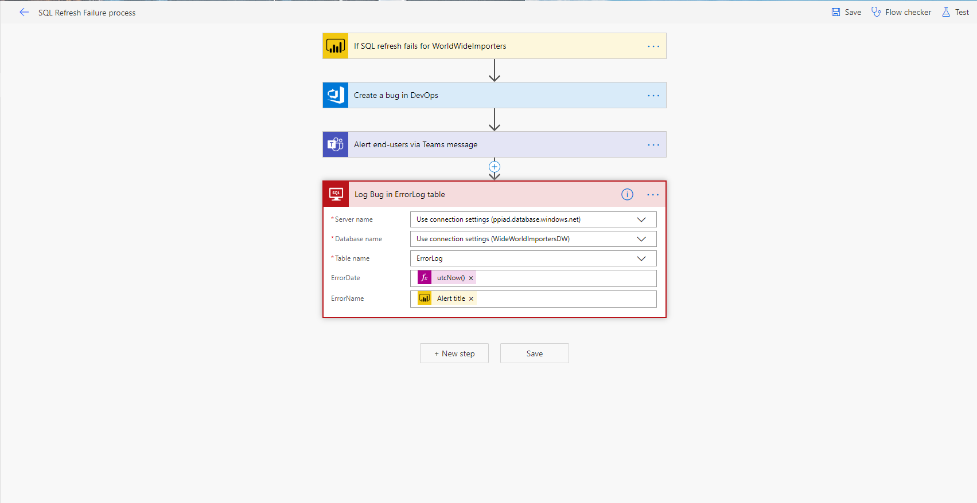
Lab work
Alert the right team if data doesn’t refresh properly
Create a bug
Notify the end users that you found a bug
Create a log entry for that bug
Notes:
Alert IT if a refresh fails
Create a bug
Notify the sales team when the bug is caught and resolved
Log the bugs somewhere for later review

Slide 18
Lunch | Q&A
CONFIDENTIAL

Slide 19
Business scenario
19
Notes:
Your new system has been humming along nicely. Your boss is happy and so is Kevin.
After a month or so, sales are improving and your boss calls you to talk
She has an idea
With sales improving, she wants the ability to assign a stretch goal to a region and have them be notified of the change
She’d really like to do this directly in a Power BI report if possible, so she can see and edit the data

Slide 20
TIME OUT
LET’s talk PROCESS & BEST PRACTICES
Notes:
Going back through our process, reconsider your tools, is Power Automate still the best tool?
You can technically edit underlying data, but not in an easy fashion

Slide 21
power APPS
1
DATA CONNECTIONS
A myriad source connectors, including CDM/CDS
Use ‘Start from Data’
2
CANVAS APPS
The best and easiest place to start
Many pre-made apps freely available
3
MODEL-DRIVEN APP
Apps heavily influenced by your data model
4
ADVANCED APPS
Portals, AI, and more

Slide 22
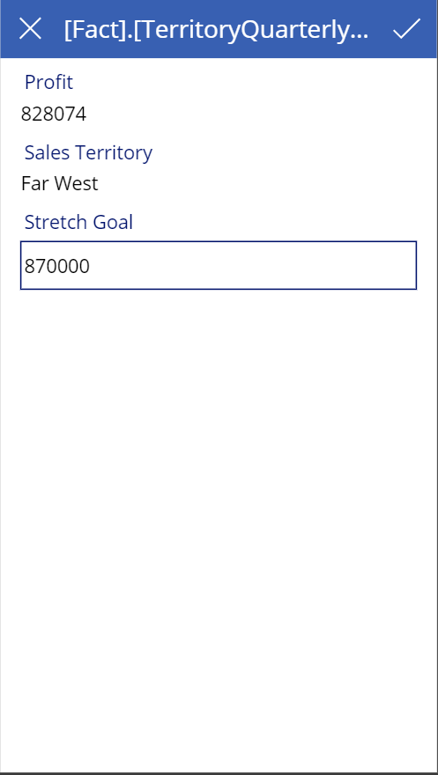
Lab work
Create a stretch goal to a sales region
Notify the sales team
Notes:
Create a stretch sales goal
Notify the sales team

Slide 23
Business scenario
23
Notes:
Now she wants an app where they can promote and leave praise for one another

Slide 24
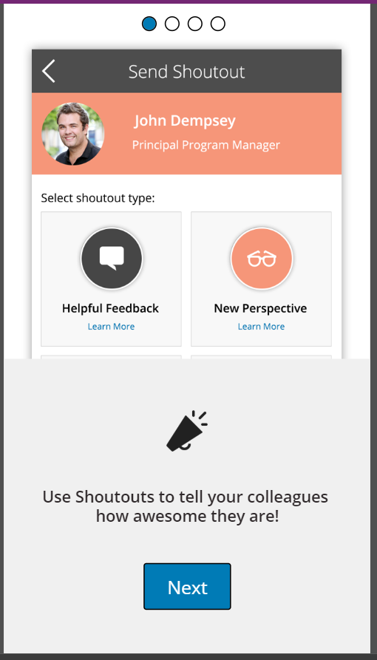
Lab work
Create an app which allows employees to recognize each other
Notes:
This app exists, just needs pointed at your O365 account

Slide 25
GOVERNANCE
The million dollar question
“This is all fine and dandy, but I’m an admin and letting everyone create their own everything sounds like madness.
How do we govern the Power Platform?”
Notes:
Discuss the Power BI and Power Apps Adoption Frameworks
Discuss Admin privileges and roles
Discuss user groups and CoEs

Slide 26
Bring your own data

Slide 27
Follow up & resources
Valorem Events
Power Platform tutorials
Power Platform Adoption Framework
Power Platform Community groups
Partnering with Valorem
This Not That vlog

Slide 28
Thank you
Hobbs Digital Insights Consultant
jhobbs@valorem.com

